Slide 1
Corporal Punishment
Ryan Neale
Jeffrey Deng

Slide 2
What is Corporal Punishment?
Corporal punishment is physical punishment.
Examples include; beating, spanking, belting, whipping…
Usually found in countries like:
Afghanistan,
Singapore,
Malaysia,
Taiwan.
Undertaken in domestic, school and judicial forms.

Slide 3
Quote and Connection #1
“ My father could have made good money selling [handcrafted bows], but if the officials found out he would have been publicly executed for inciting a rebellion...”- The Hunger Games pg. 6
The connection between this quote and the world is that many countries do not tolerate house made weapons for similar reasons.

Slide 4
Quote and Connection #2
“Rue’s eyes widen. ‘Oh no, we’re not allowed to eat the crop.’ ‘They arrest you or something?’ I ask. ‘They whip you and make everyone else watch,’ says Rue. ‘The mayor’s very strict about it…”- The Hunger Games pg. 202
This particularly reminds me of many developing areas around the world that cannot afford to eat off their own property for economic reasons.

Slide 5
Quote and Connection #3
“The Avox Girl: ‘Someone who committed a crime. They cut out her tongue so she can’t speak... She’s probably a traitor of some sort… you’re not to speak to one of them unless it’s to give an order.”- The Hunger Games pg. 95
In the Middle Ages, thieves who stole would get their hands chopped off as a punishment. There is a clear connection between these two dystopian worlds/ages.

Slide 6
Quote and Connection #4
“Beyond us there’s only wilderness. If you don’t count the ruins of District 13 that still smoulder from the toxic bombs. They show it on television occasionally, just to remind us.”- The Hunger Games pg. 101
The connection here is that some countries (that have had ‘revolutions’) still warn people not to retaliate against the new ‘ways’.

Slide 7
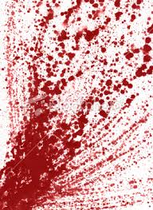
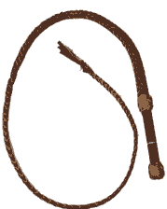
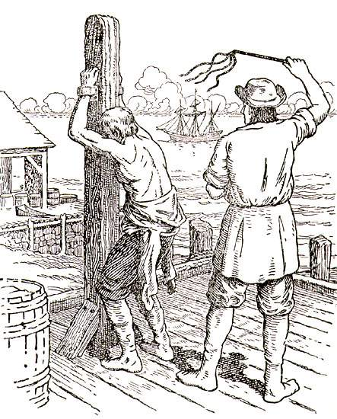
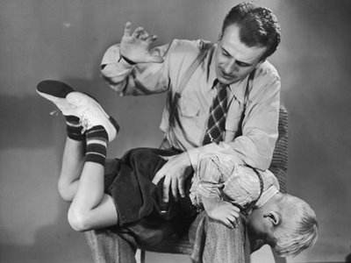
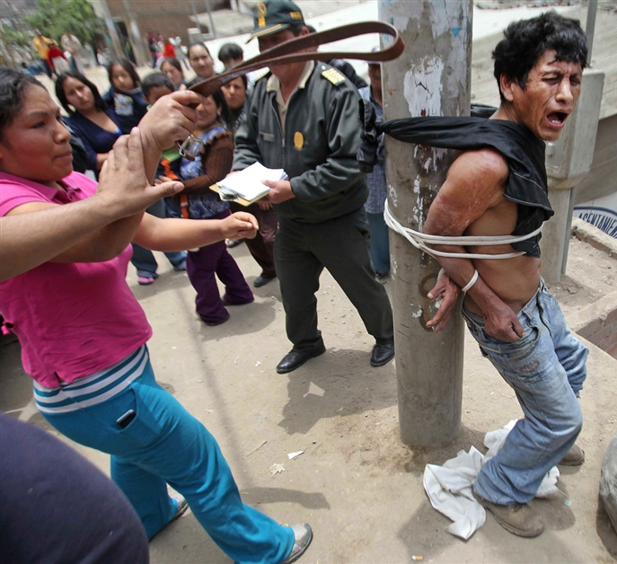
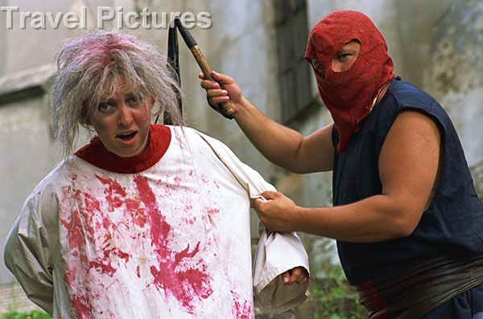
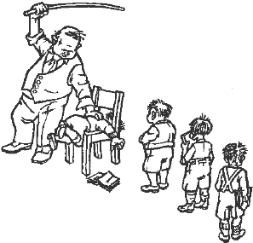
Gallery

Slide 8
Thanks for listening

